Slide 1
Introduction to Operations Manual

Slide 2
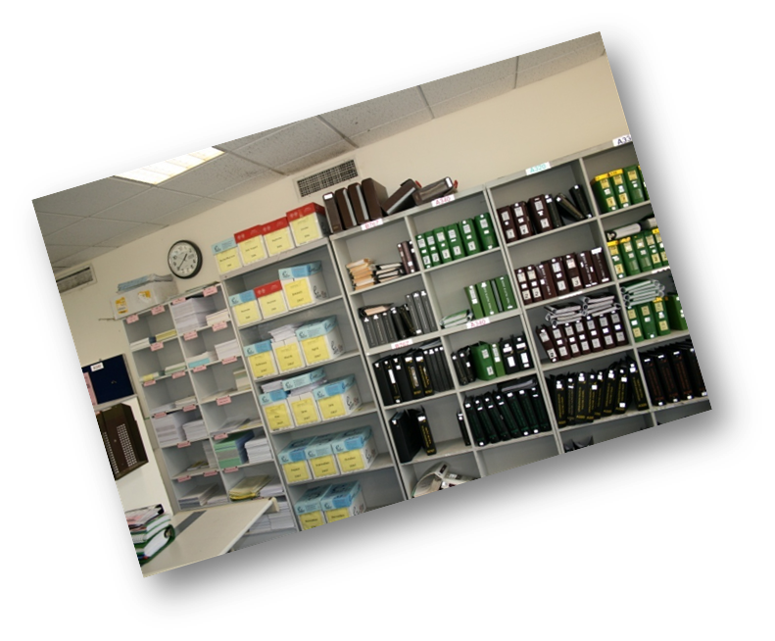
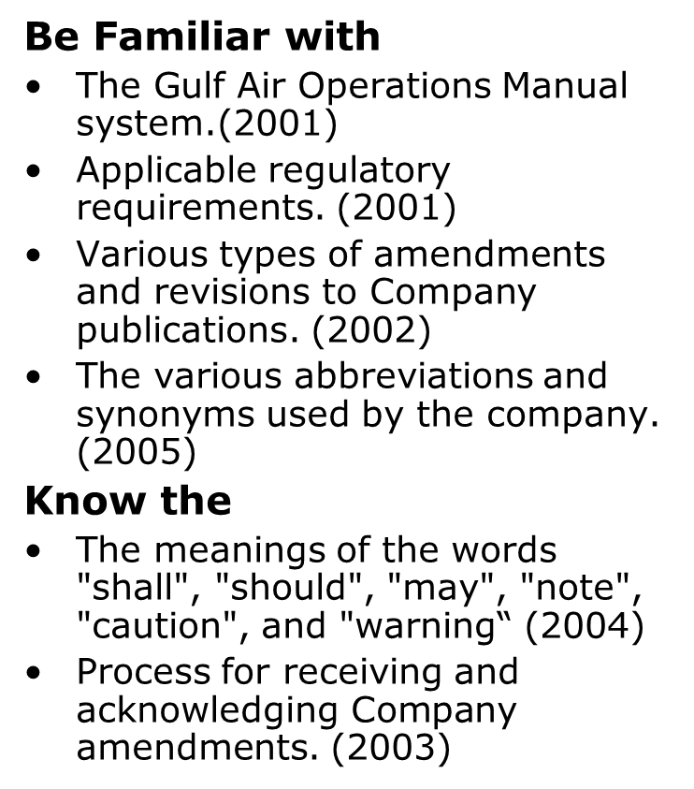
Objectives
By completing this module, you will:

Slide 3
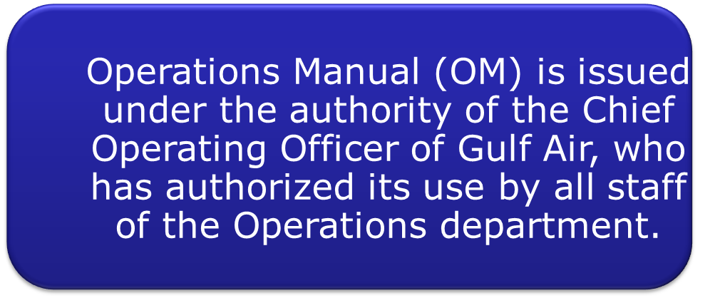
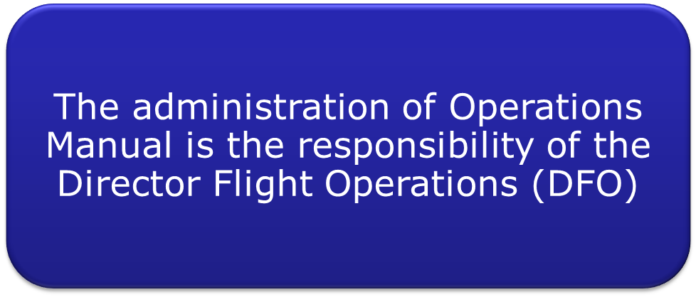
Company Authority

Slide 4
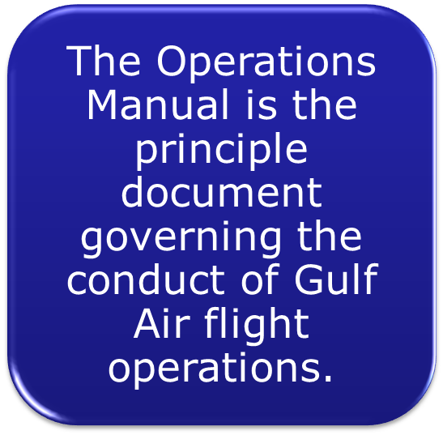


Regulatory Authority

Slide 5



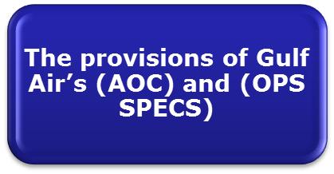
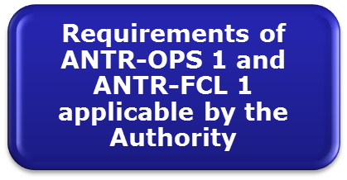
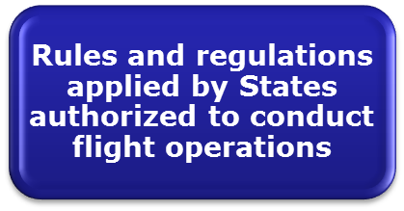
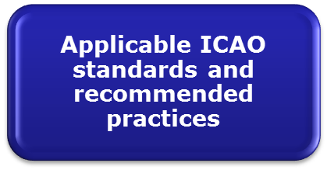
Regulatory Requirements

Slide 6
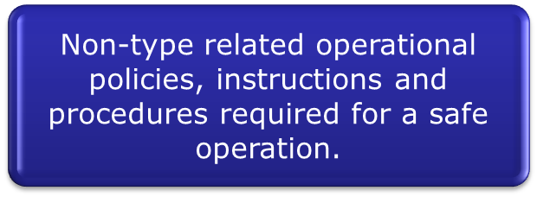


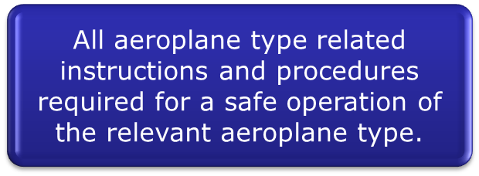




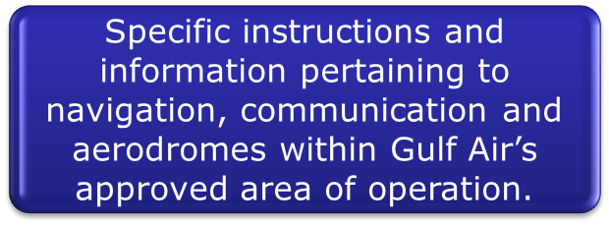
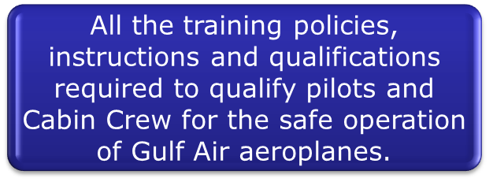
Gulf Air Operations Manual System
Part A
Operations Manual (OM)
Part B
Part C
Part D

Slide 7
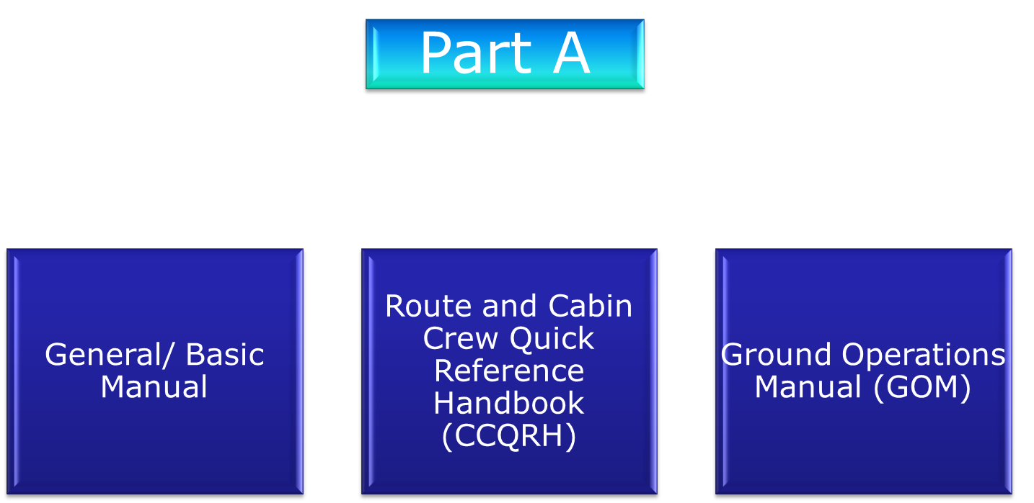



Gulf Air Operations Manual System

Slide 8
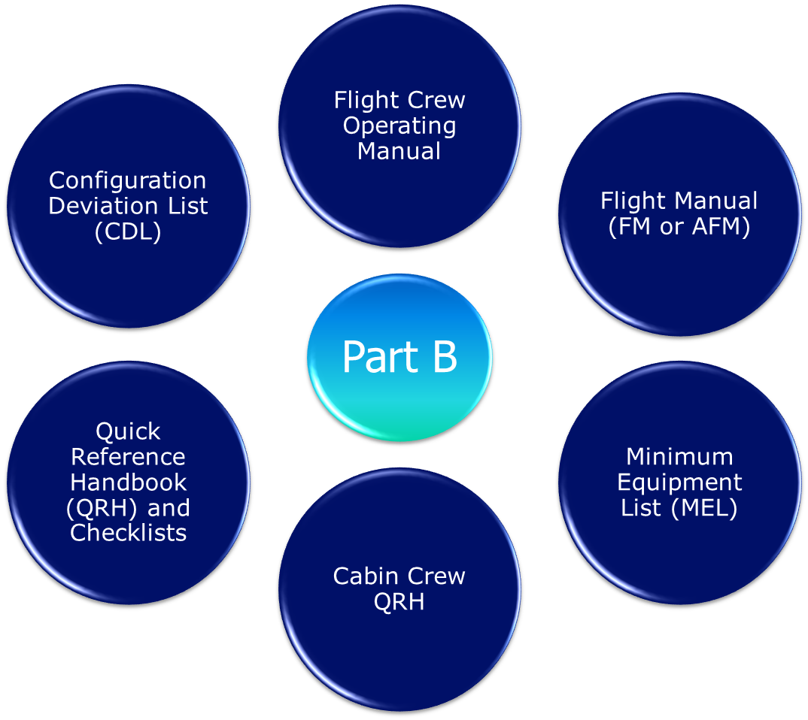

Gulf Air Operations Manual System

Slide 9
Gulf Air Operations Manual System
Take-off Data Manual
OM-C Manual
Part C
NOTAMS (edited by the Company)
Jeppesen Route Manual

Slide 10
Gulf Air Operations Manual System
Appendix L - A320 Fleet Training Syllabi
Flight Crew Training Manual - A320, A330/A340
Appendix M - A330 Fleet Training Syllabi
Part D Vol 1
Appendix N - A340 Fleet Training Syllabi
Fleet Training Manuals - A320, A330/A340
Appendix P - SEP Training Manual

Slide 11
Gulf Air Operations Manual System
Part D Vol 2
AQP Training manual Appendix
AQP Training Manual
AQP instructor Guide

Slide 12
Gulf Air Operations Manual System
Part D Vol 5
Ground Staff Initial Qualification Curriculum
Ground Staff Continuing Qualification Curriculum

Slide 13

Gulf Air Operations Manual System
OM Part
Description
Aircraft
Pilots
Cabin Crew
CAA
Briefing Rooms
Ops & TRG Offices
Out-Station
Part A
GENERAL
Part A
Cabin Crew QRH
X
Part A
GOM
X
Part B
Airplane Specific
X
X
Part B
FCOMs
X
X
Part B
QRH
X
X
Part C
GENERAL
X
X
Part C
Jeppesen
X
X
X
X
Part D
Volume TWO
X
X
X
X
Part D
Volume 5
X
X
X
X
X

